Slide 1
chapter 8 Security, privacy and integrity
8.1 security

Slide 2
Syllabus
explain the difference between the terms , privacy and integrity of data
show appreciation(鉴别) of the need for both the security of data and the security of the computer system
describe security measures designed to protect computer systems, ranging from the stand-alone PC to a network of computers, including:
– user accounts – firewalls
– general authentication techniques, including the use of passwords and digital signatures(数字签名)
describe security measures designed to protect the security of data, including:
– data backup – a disk-mirroring strategy – encryption(加密)
– access rights to data (authorisation)
show awareness of what kind of errors can occur and what can be done about them

Slide 3
Differences among security, privacy and integrity
Explain the difference between the terms security, privacy and integrity of data
Data integrity: a requirement of data to be accurate and up to date
Data privacy: a requirement for data to be available only to authorized(被授权) users
Data security: a requirement for data to be recoverable if lost or corrupted

Slide 4
Security for protecting computer system
Aims
  Ensure system functionality
  Ensure authorized users have access to the system
Problem
  Internal mismanagement(管理不善)
  Natural disasters
  Unauthorized intrusion(未经许可闯入) into the system by an individual
  Malicious(恶意) software entering the system

Slide 5
Authentication
Authentication: verification(验证) of a user’s identity
User account (user name and Password or SMS verification code短信验证码 or QR code二维码)
Biometric method (fingerprint or the face or the eye )

Slide 6
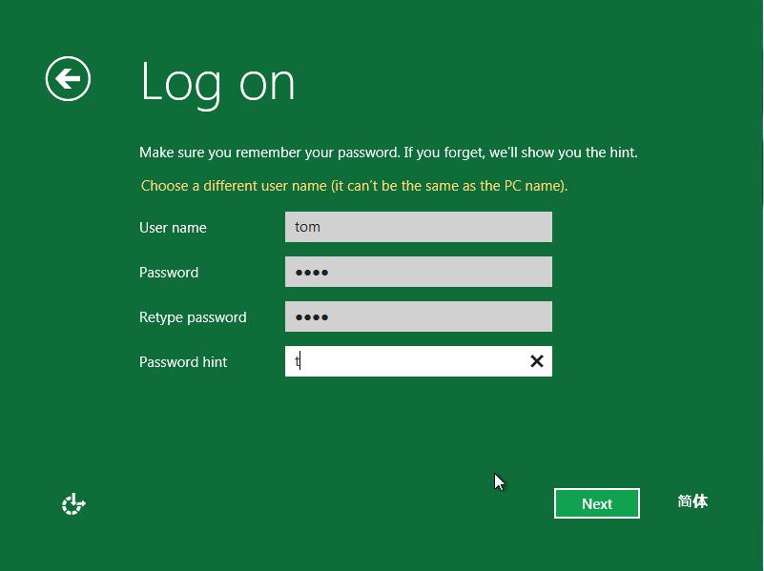
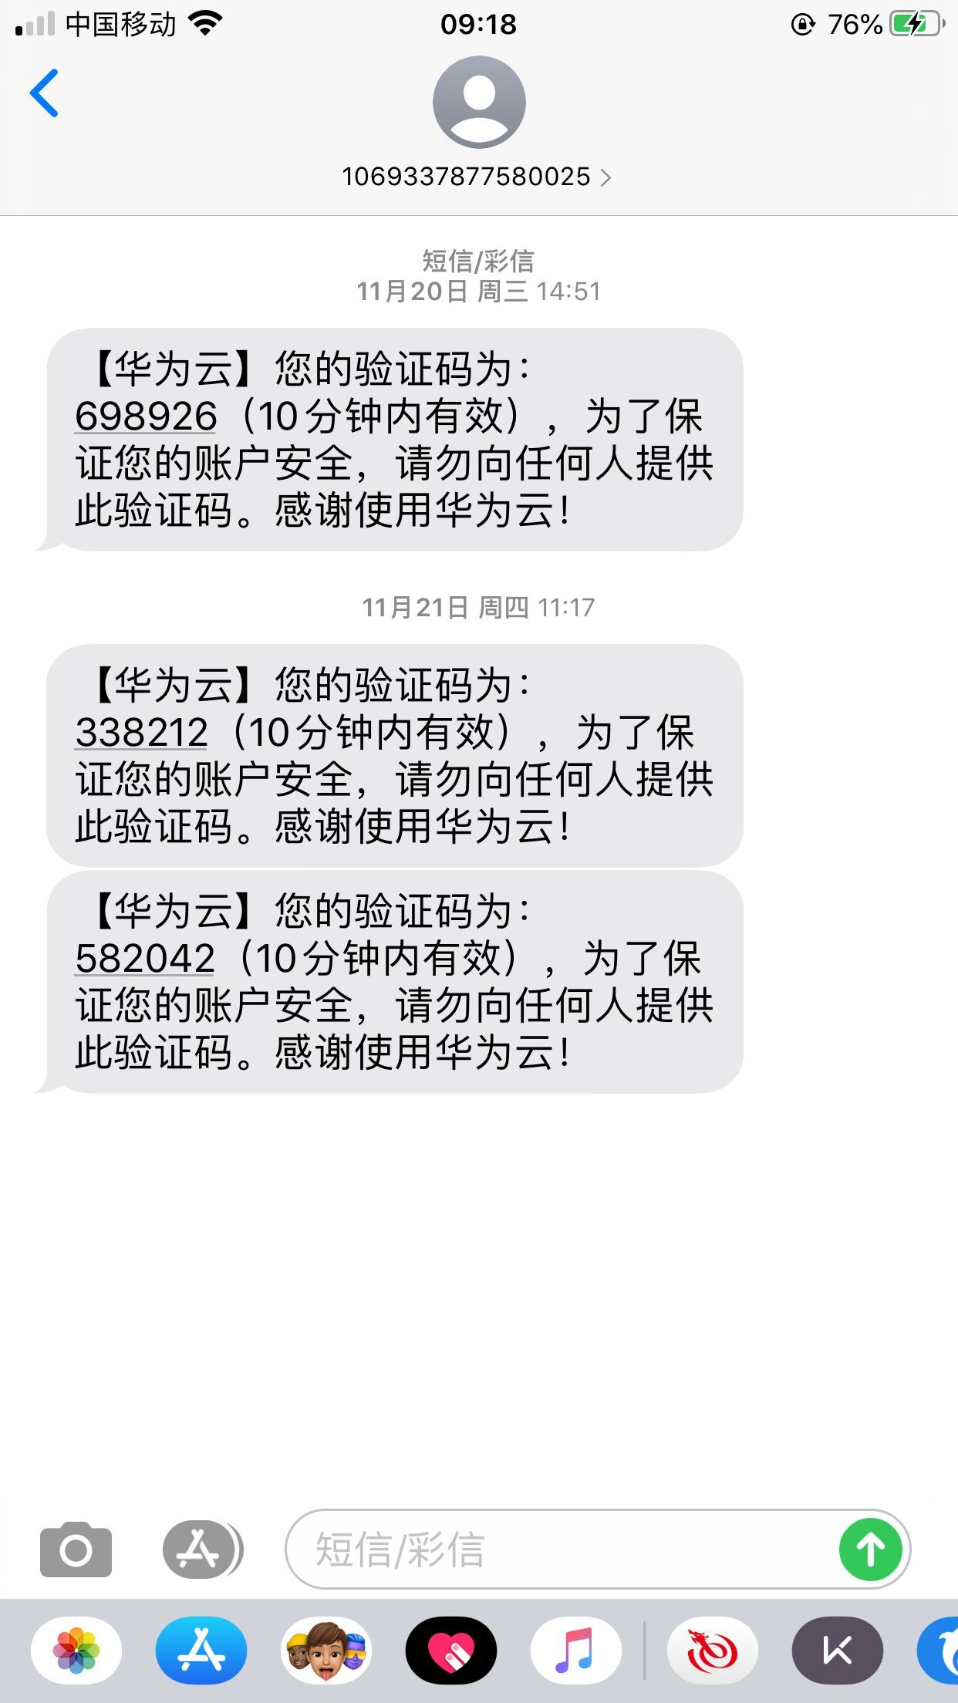

User account

Slide 7
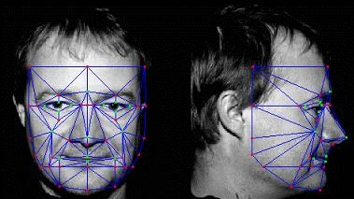
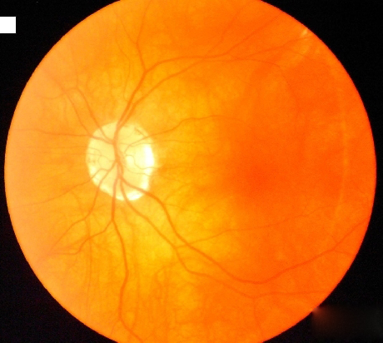

Biometrics identifiers
(生物技术识别)

Slide 8
Malicious(恶意的) software
Malicious code is used to describe any code in any part of a software system that is intended to cause undesired effects or damage to a system.
Malicious code includes attack scripts(攻击脚本), viruses, Trojan horses(特洛伊木马), backdoors(后门程序), and malicious active content. video
Install a firewall (hardware and software)
Digital certificate

Slide 9
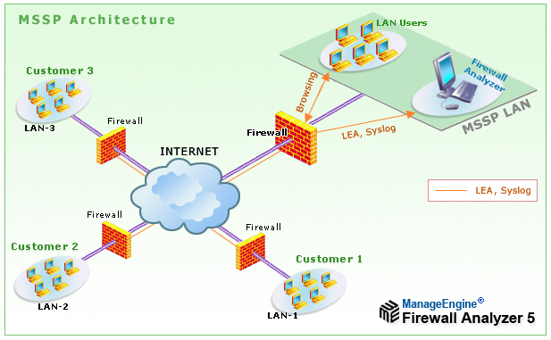


Firewall
A technological barrier designed to prevent unauthorized or unwanted communications between computer networks or hosts.
A firewall is software or hardware located between a computer and the network to which it is connected (of which hardware firewalls are used less often, such as in the Department of Defense(国防部门) and large computer rooms, because it is expensive)

Slide 10
Digital certificate(数字证书)
A digital certificate, also known as a public key certificate, refers to electronic data that is used to verify and prove the subject of an electronic document in electronic information activities, and to achieve the confidentiality(机密性) and integrity(完整性) of the electronic document.
Digital certificates contain many numbers and letters(字母). When digital certificates are used for identity authentication, it will randomly generate a 128-bit identity code. Each digital certificate can generate a corresponding number but cannot be the same each time, thereby ensuring data.

Slide 11
SSL/TLS
SSL(Secure Sockets Layer 安全套接层)
TLS (Transport Layer Security传输层安全)

Slide 12
Security for protecting data
Recovering from data loss
Restricting access to data
Protecting data content

Slide 13
Recovering from data loss
A disk gets corrupted
A disk is destroyed
The system crashes
The file is erased by mistake
The location of the file is forgotten
A full backup is made at regular intervals(定期)
At least two generations of full backup are kept in storage
Incremental backups are made everyday
Use a disk-mirroring strategy

Slide 14
Data backup
Data backup is the basis of disaster recovery. It refers to the process of copying all or part of the data set from the hard disk to other storage media in order to prevent system operation errors or system failures from causing data loss.
Backup method:
Periodic tape
Database
Network data
Remote mirroring

Slide 15
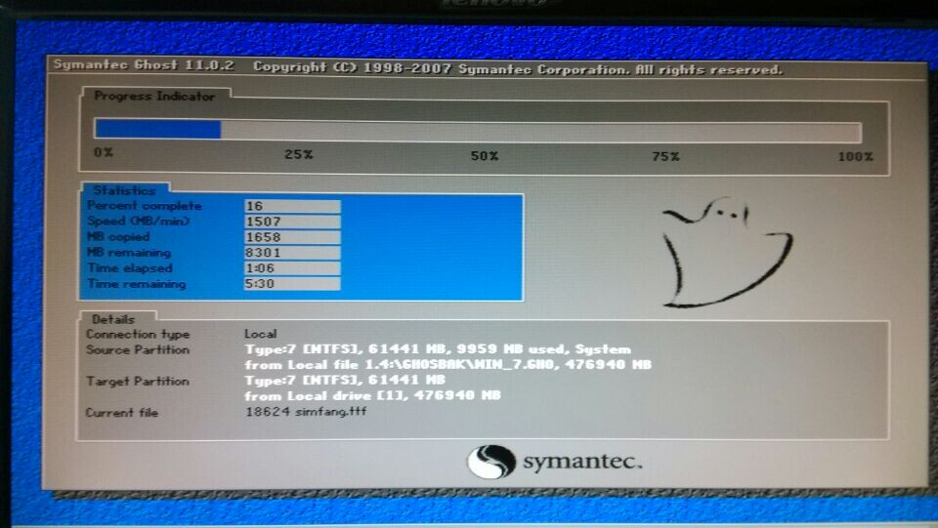
Disk mirroring
In data storage, disk mirroring is the replication(copy) of logical disk volumes(逻辑磁盘卷) onto separate physical hard disks in real time to ensure continuous availability(持续可用性).

Slide 16
Access rights to data (authorisation)
The user is 'authorised' to use certain files or programs.
Individual files can be password protected. For example, Microsoft Office software can have a password set for access to a document.
Spreadsheet or database. When working with database software, syntax(语法) and commands of SQL are used extensively for this. SQL is used to create groups of users.
These user groups are then granted various permissions - read only; read and write, etc. - to certain objects created by the database designer; such as tables and views.

Slide 17
Protecting data content
Data encryption is a technology with a long history, which means that the plaintext(明文) is converted to ciphertext(秘文) by using an encryption algorithm and an encryption key, and the decryption(解密) is to restore the ciphertext to plaintext by using a decryption algorithm and a decryption key. Its core is cryptography(密码学).
More click here

Slide 18
What to do when an error occurs
The system should record repeated unsuccessful attempts at logging on by a user account. The user account or terminal could be disabled after; for example, three wrong passwords have been entered.
The network operating system will generate a log of all user usage.
When the database data is lost or an error is reported, we can delete the corresponding data and restore it with a backup file.

